Slide 1
WBSCM User Roles
USDA Foods
Texas Department of Agriculture

Slide 2
2
Why WBSCM?
The FDP Module in TX-UNPS does not have an upgrade.
In 2010, USDA launched the Web Based Supply Chain Management System (WBSCM) specifically to support FDP.
USDA owns and regularly upgrades WBSCM, making it the best solution to serve RAs in Texas now and in the future.

Slide 3
3
WBSCM User Administrator-RA
Manage and Maintain User Details
Can create new users
Cannot create another User Administrator
Only one User Administrator per organization
Update contact information and assigned roles for users within their RA organization
Deactivate accounts that are no longer needed
User Security Report
Provides details on all users (including locked and deleted)
Monitors non-active users
Confirms and validates role assignments and Status or organization users
Validates users have maintained correct email and contact information

Slide 4
4
WBSCM Order Manager-RA
Order Management:
Create Domestic Order Entry
Reports:
Run Entitlement/Bonus Summary Report
Run RA Entitlement/Bonus Detail Report
Shipment Receipts (*Direct Ship RAs Only):
Enter Shipment Receipt
Upload Shipment Receipt

Slide 5
5
WBSCM Organization Administrator-RA
Manage Users
Can view users
Organization Maintenance
Can manage organization information
User Security Report
Provides details on all users (including locked and deleted)
Monitors non-active users
Confirms and validates role assignments and Status or organization users
Validates users have maintained correct email and contact information
Note: Org. Admins do not perform user maintenance unless a User Admin is not assigned or active.

Slide 6
6
WBSCM View Only-RA
Has access to order management and entitlement reports.
List of Materials
Material Pricing Report
Entitlement/Bonus Summary Report
Entitlement/Bonus Detail Report
Domestic Ship-To Contacts Report
Requisition Status Report
Redistribution/Redonation Detail Report
Value of Commodities Received - RA Report

Slide 7
7
WBSCM View Only-SDA (for ESCs)
Has TDA-level access to order management, material pricing, and entitlement reports.
Domestic Price Support Report
Domestic Ship-To Contacts Report
Entitlement/Bonus Summary Report
List of Materials
Material Outlay Report
Material Pricing Report
Order Status Report
Processing Status Report
RA Entitlement/Bonus Detail Report
Received Shipment Report
Redistribution/Redonation Detail Report
Requisition Status Report
SDA Entitlement/Bonus Detail Report

Slide 8
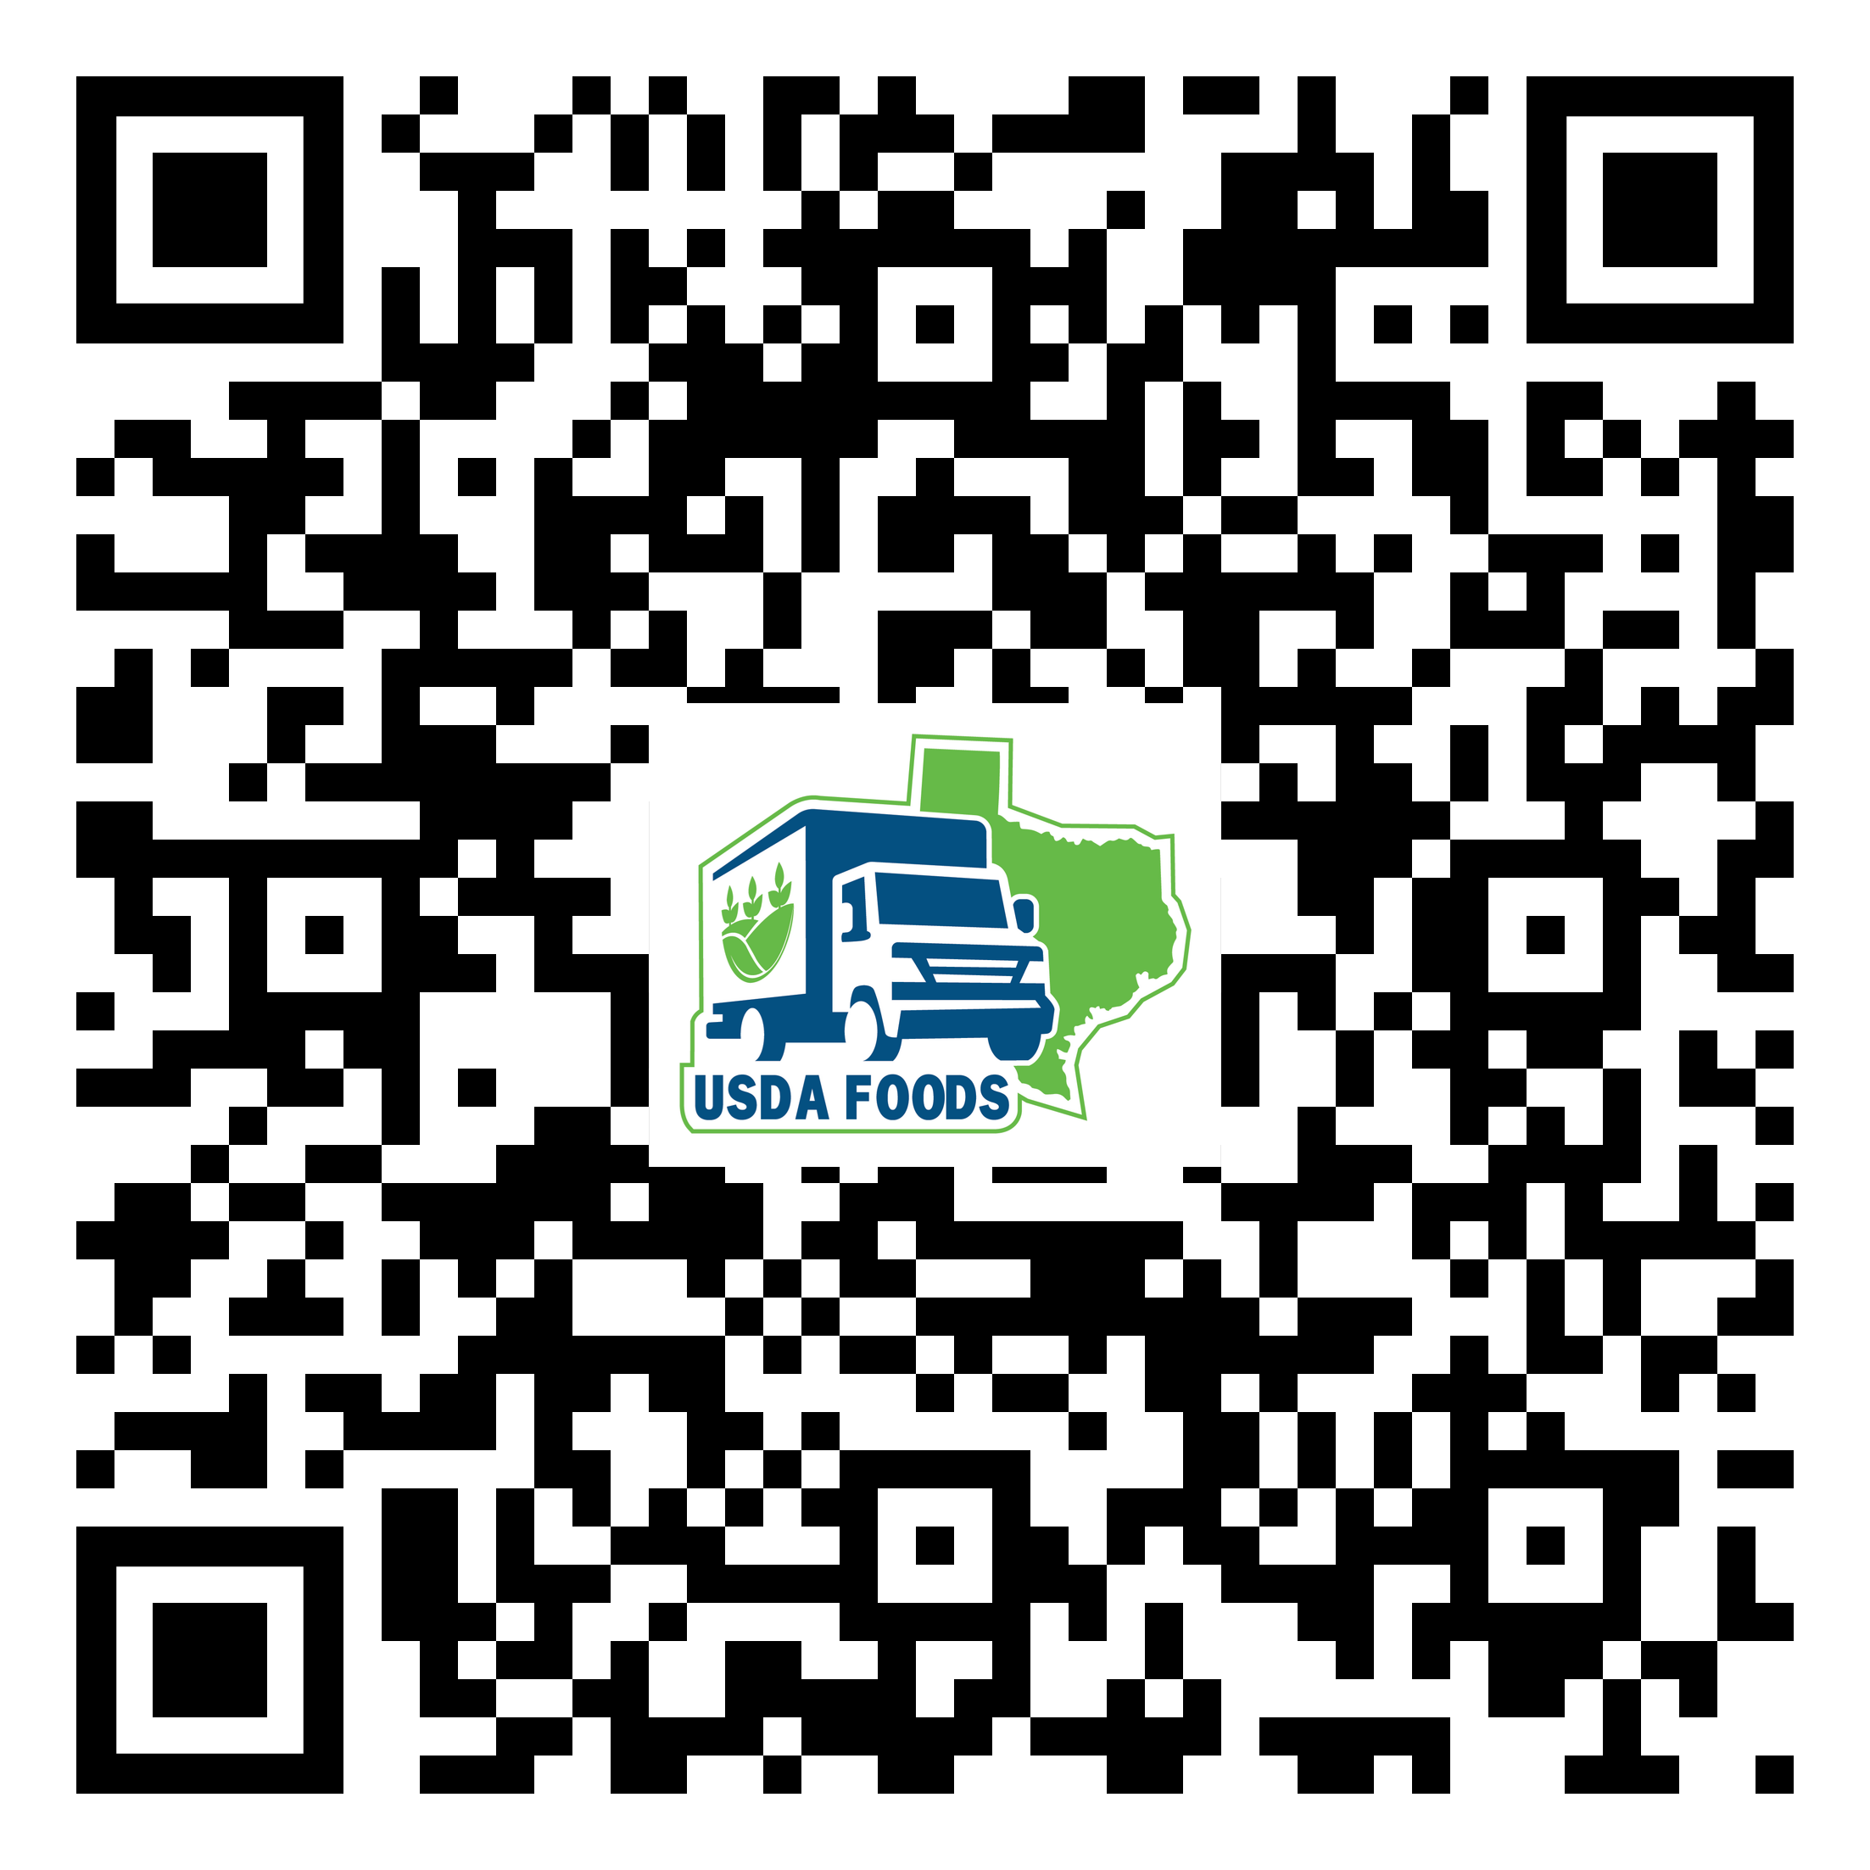
CONTACT
Diana Chavarria
Diana.Chavarria@esc15.net
https://squaremeals.org/Programs/FDPWBSCMTransitionProject.aspx

